Slide 1

Pioneering a Diagnostic Tool for Bone Diseases
Lily Wayne, Wang Zheng, Steve Romaniello, Ariel Anbar

Slide 2

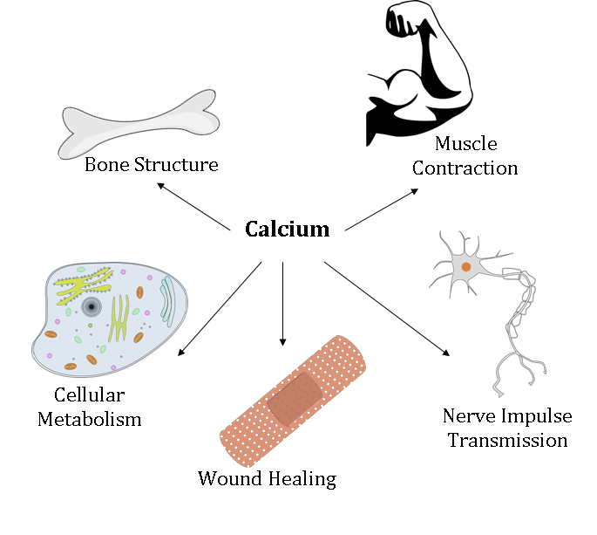
Background
99% of calcium stored in bones/teeth and 1% found in serum
Calcium homeostasis maintained by parathyroid hormone and calcitonin
Osteoporosis affects 44 million Americans over the age of 50
weak brittle bones and an increased risk for hip fractures
diagnosed using dual energy x-ray absorptiometry (DEXA)

Slide 3
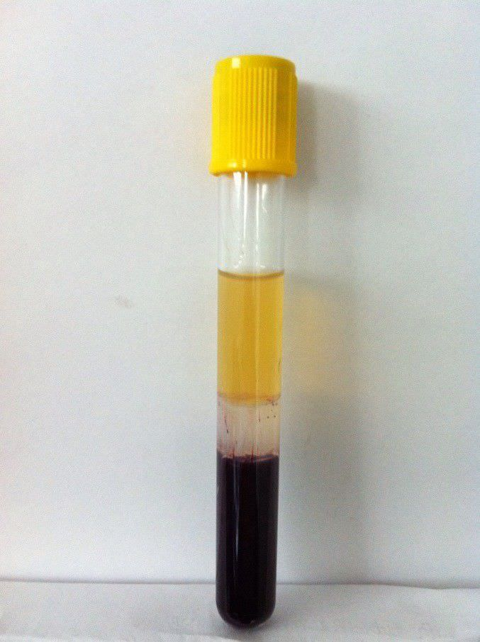
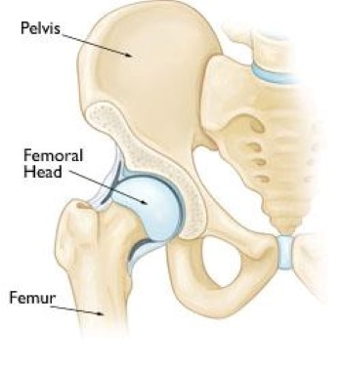
Research Project
Goal: Analyze calcium isotope concentrations in bones and serum to understand bone loss conditions

Slide 4
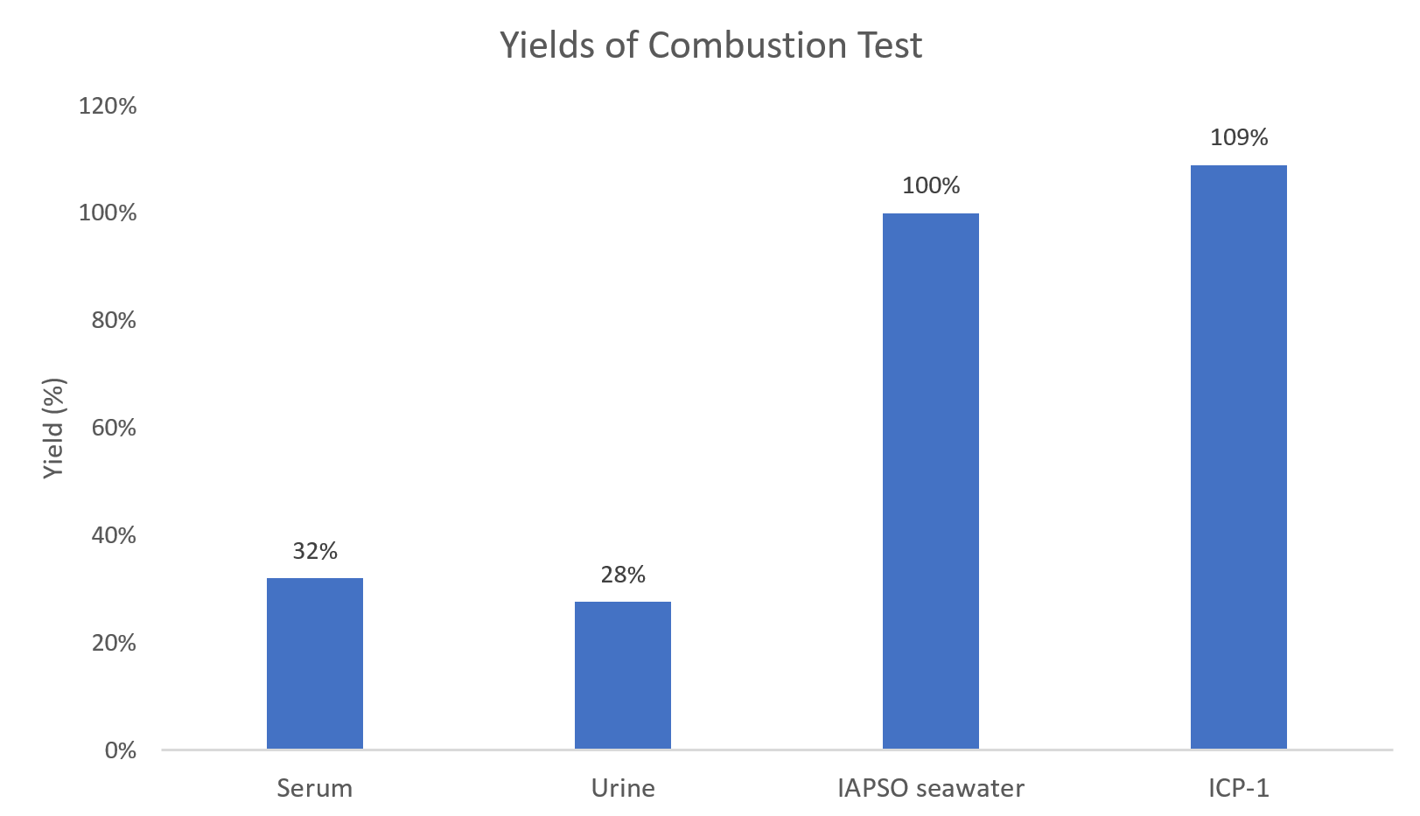

Slide 5
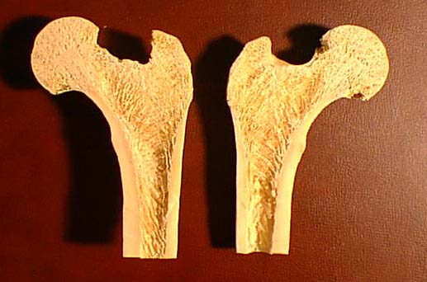
Trabecular
Cortical

Slide 6
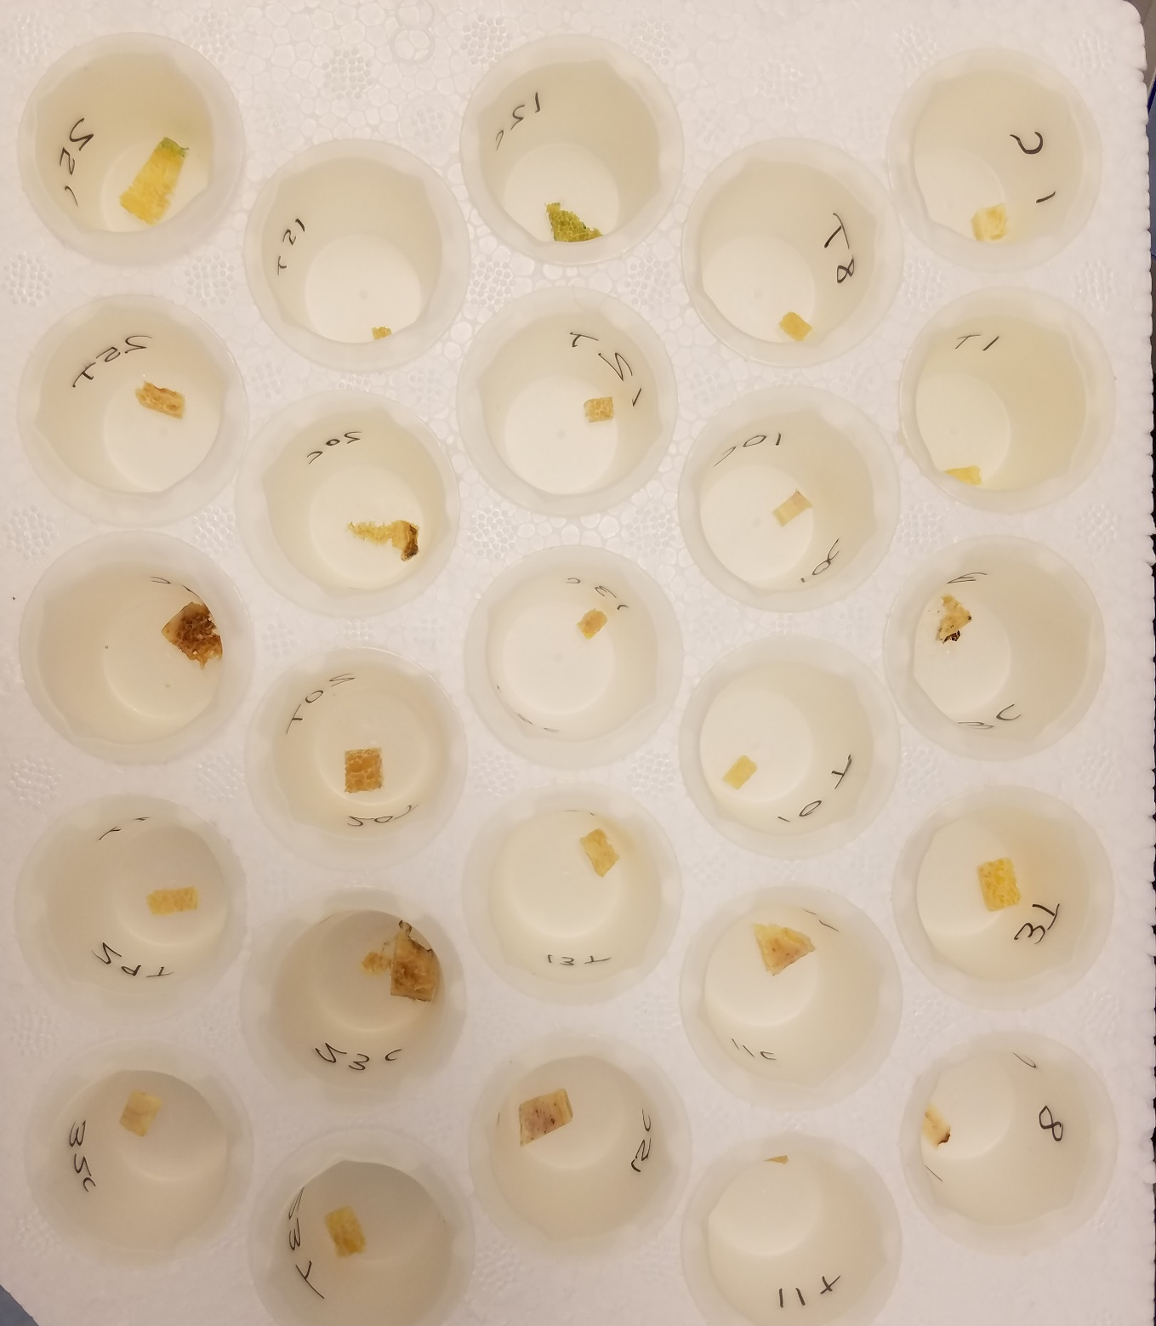


Slide 7
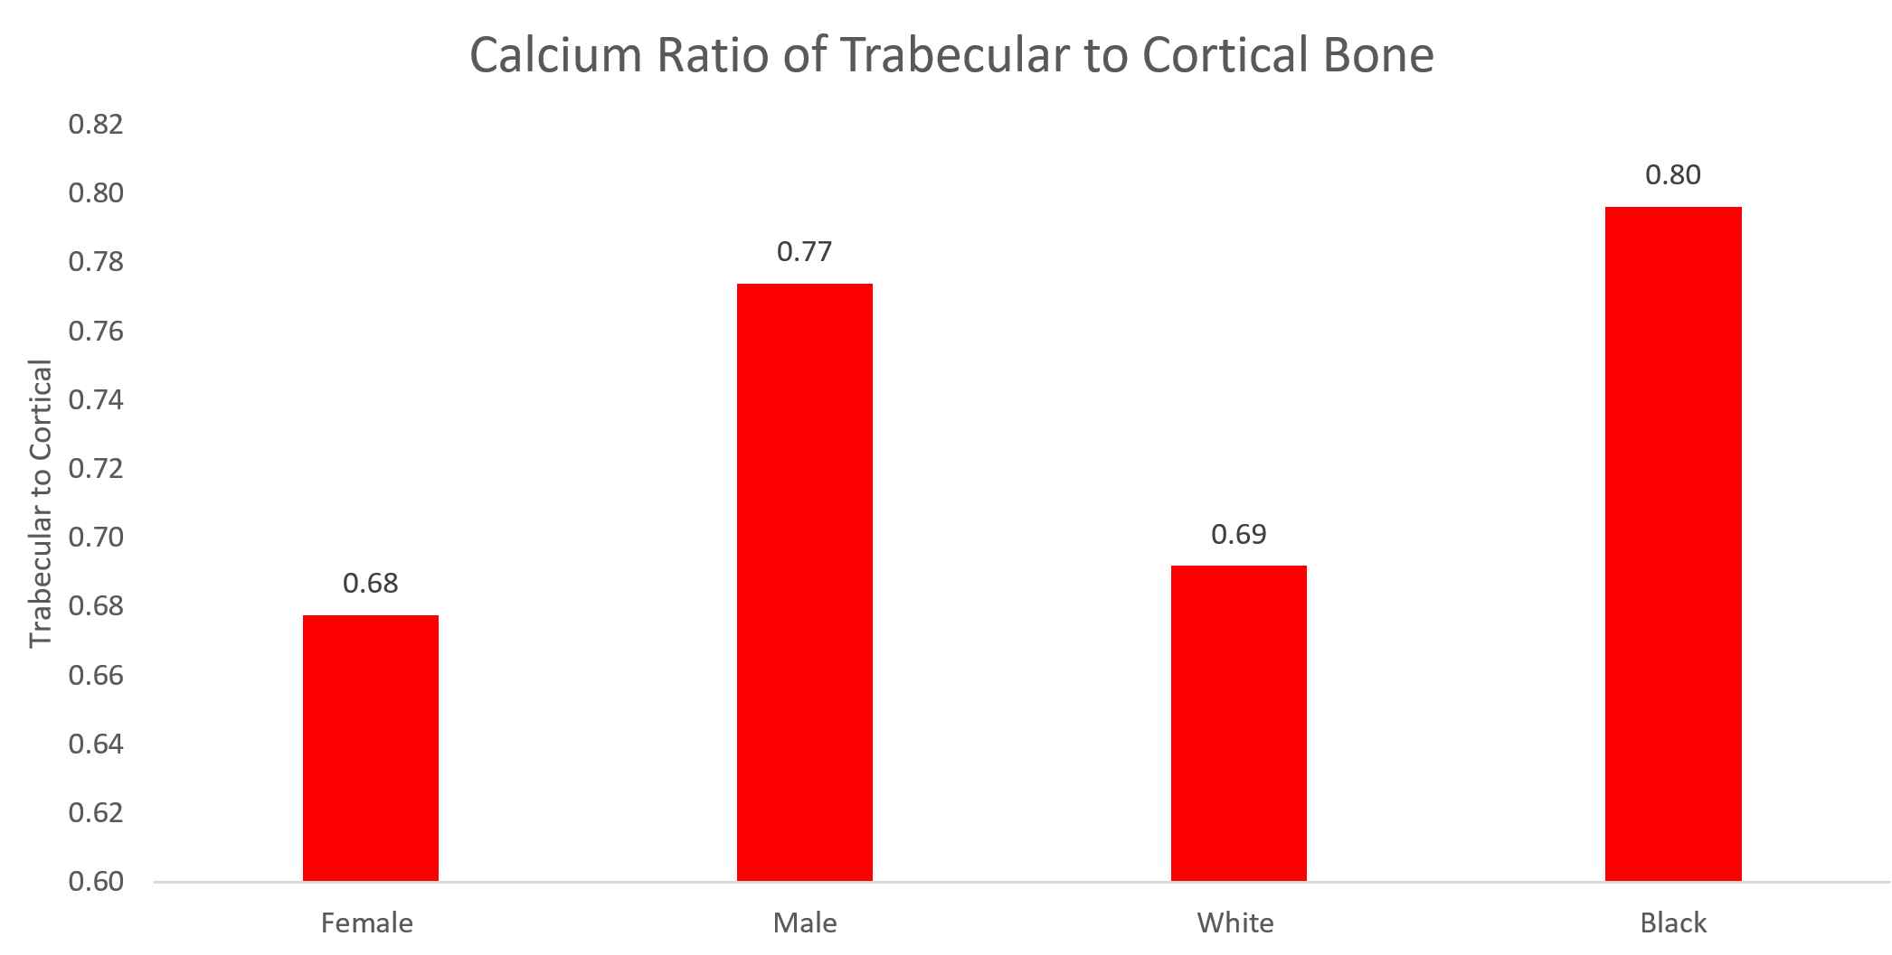

Slide 8
Acknowledgements
Wang Zheng, Assistant Research Scientist at ASU
Steve Romaniello, Assistant Research Scientist at ASU
Ariel Anbar, President’s Professor at ASU
ASU/NASA Space Grant

Slide 9
Thank you

